Slide 1

Principles of supervised ML
Linear regression, overfitting, regularization, classification
Dr. Andrea Staino
School of Engineering, Trinity College Dublin
Alstom Digital and Integrated Systems
Principles of supervised ML
Computation for Transportation Engineering – Hilary Term 2024

Slide 2

Today’s plan
Linear regression
Overfitting
Regularization techniques
Classifiers
Principles of supervised ML
Computation for Transportation Engineering – Hilary Term 2024

Slide 3
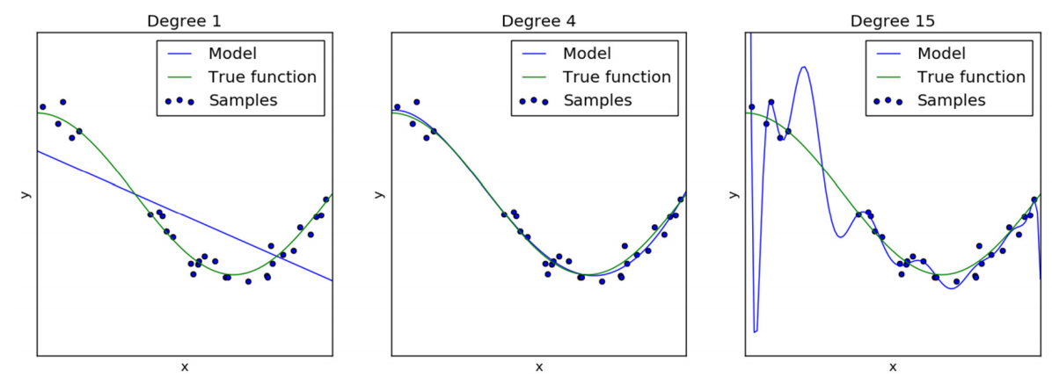
Model fitting: Underfitting and Overfitting
Principles of supervised ML
Computation for Transportation Engineering – Hilary Term 2024

Slide 4
Overfitting
“Common” definition: “overfitting occurs when a model performs well (in some sense, ed.) on the training set but poorly on the test set” (in other words, it doesn’t generalize, ed.).
A good ML model is one that generalizes to data that it has not “seen” before.
To your knowledge, what are possible causes of overfitting in Machine Learning?
Principles of supervised ML
Computation for Transportation Engineering – Hilary Term 2024

Slide 5
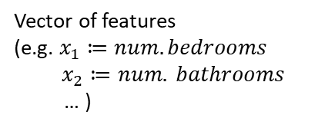

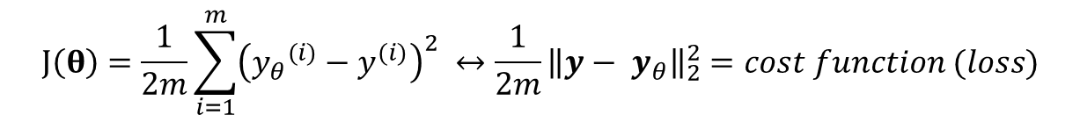
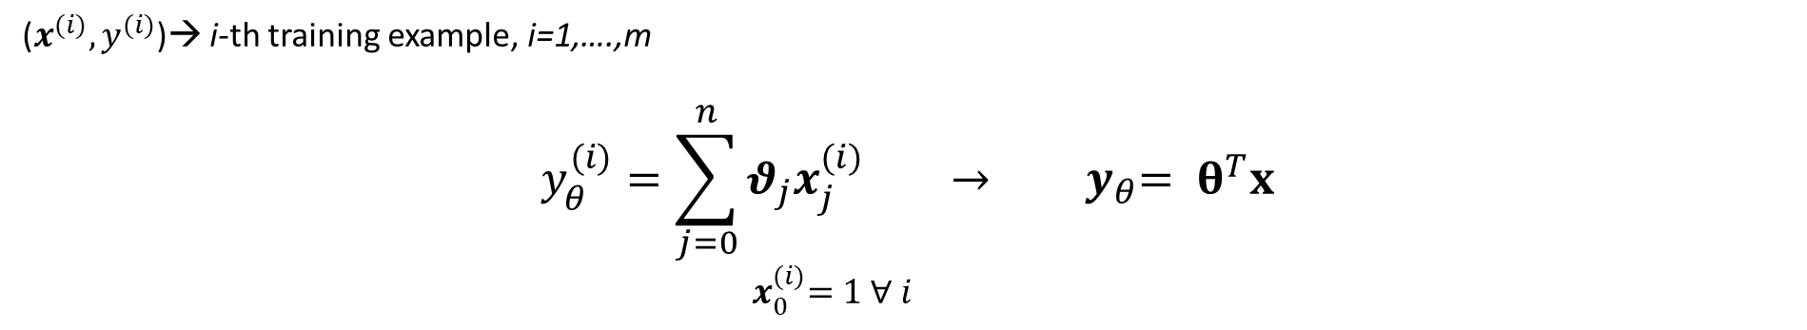
Linear regression
($x^{(i)}, y^{(i)}$)→ i-th training example, i=1,….,m
$$y_{θ}^{(i)}=\sum_{j=0}^{n}{θ_{j}x_{j}^{(i)}} → { y}_{θ}= θ^{T}x$$
${ x}_{0}^{(i)}=1 \text{∀} i$
What are the dimensions of these matrices?
$$x=\{x_{1}, x_{2},…,x_{n}\}$$
Vector of features
(e.g. $x_{1}≔num. bedrooms$
$$x_{2}≔num. bathrooms$$
… )
(1)
on the training dataset
minimizes
$$J\left(θ\right)=\frac{1}{2m}\sum_{i=1}^{m}{{\left({y_{θ}}^{(i)}−y^{(i)}\right)}^{2}} ↔\frac{1}{2m}{\left\|y−{ y}_{θ}\right\|}_{2}^{2}=cost function (loss)$$
$$θ= {\left(x^{T}x\right)}^{−1}x^{T}y_{θ}$$
Solve (1) for
Where are the “possible causes of overfitting” we mentioned before coming into play here?
Principles of supervised ML
Computation for Transportation Engineering – Hilary Term 2024

Slide 6

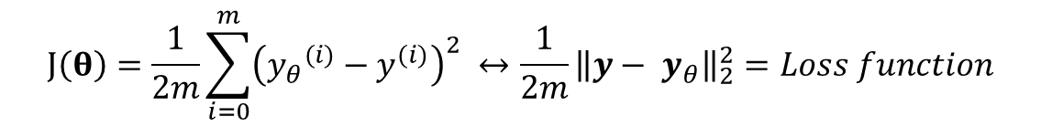

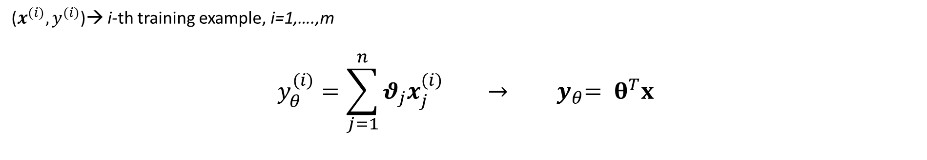
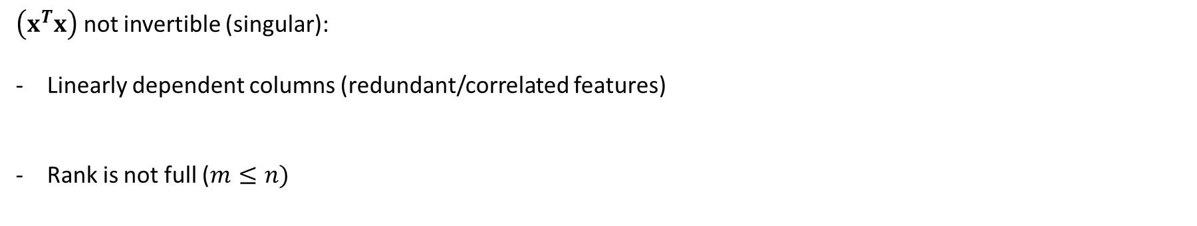
Linear regression
($x^{(i)}, y^{(i)}$)→ i-th training example, i=1,….,m
$$y_{θ}^{(i)}=\sum_{j=1}^{n}{θ_{j}x_{j}^{(i)}} → { y}_{θ}= θ^{T}x$$
What are the dimensions of these matrices?
$$x=\{x_{1}, x_{2},…,x_{n}\}$$
Vector of features
(e.g. $x_{1}≔num. bedrooms$
$$x_{2}≔num. bathrooms$$
… )
on the dataset
minimizes
$$J\left(θ\right)=\frac{1}{2m}\sum_{i=0}^{m}{{\left({y_{θ}}^{(i)}−y^{(i)}\right)}^{2}} ↔\frac{1}{2m}{\left\|y−{ y}_{θ}\right\|}_{2}^{2}=Loss function$$
$$θ= {\left(x^{T}x\right)}^{−1}x^{T}y_{θ}$$
Solve (1) for
$\left(x^{T}x\right)$ not invertible (singular):
Linearly dependent columns (redundant/correlated features)
Rank is not full ($m≤n)$
$$x_{k}=surface in sqft$$
$$x_{l}=surface in sqm$$
Training dataset is too small (too few examples → put more)
Too many features (model is too complex → features selection, regularization)
Principles of supervised ML
Computation for Transportation Engineering – Hilary Term 2024

Slide 7

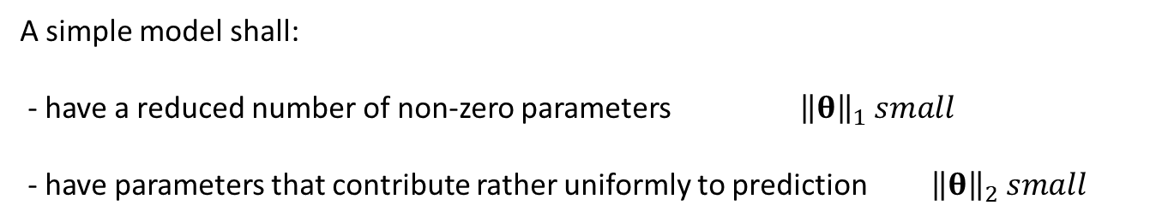
Avoid overfitting
Principle of parsimony (aka Occam’s razor): when presented with competing hypotheses about the same prediction, one should prefer the one that requires fewest assumptions.
In other words, make the model simple!
What is the hypotheses in our case?
A simple model shall:
- have a reduced number of non-zero parameters ${\left\|θ\right\|}_{1} small$
- have parameters that contribute rather uniformly to prediction ${ \left\|θ\right\|}_{2} small$
Shave away unnecessary assumptions!
Principles of supervised ML
Computation for Transportation Engineering – Hilary Term 2024

Slide 8


Regularization
Add a penalty term to the loss function (Mean Squared Error) to reduce model complexity .
L1 regularization
L2 regularization
$$J\left(θ\right)=\frac{1}{2m}\sum_{i=1}^{m}{{\left({y_{θ}}^{(i)}−y^{(i)}\right)}^{2}}+ λ \sum_{j=1}^{n}{\left|θ_{j}\right|}$$
$$J\left(θ\right)=\frac{1}{2m}\sum_{i=1}^{m}{{\left({y_{θ}}^{(i)}−y^{(i)}\right)}^{2}}+ λ \sum_{j=1}^{n}{{θ_{j}}^{2}}$$
MSE: fit the training data
MSE: fit the training data
Principles of supervised ML
Computation for Transportation Engineering – Hilary Term 2024

Slide 9


Regularization
Add a penalty term to the loss function (Mean Squared Error) to reduce model complexity .
L1 regularization
L2 regularization
$$J\left(θ\right)=\frac{1}{2m}\sum_{i=0}^{m}{{\left({y_{θ}}^{(i)}−y^{(i)}\right)}^{2}}+ λ \sum_{j=1}^{n}{\left|θ_{j}\right|}$$
$$J\left(θ\right)=\frac{1}{2m}\sum_{i=0}^{m}{{\left({y_{θ}}^{(i)}−y^{(i)}\right)}^{2}}+ λ \sum_{j=1}^{n}{{θ_{j}}^{2}}$$
Regularization term: keep the parameters small (in L1 sense)
Regularization term: keep the parameters small (in L2 sense)
Principles of supervised ML
Computation for Transportation Engineering – Hilary Term 2024

Slide 10
Regularization
Add a penalty term to the loss function (Mean Squared Error) to reduce model complexity .
L1 regularization
L2 regularization
$$J\left(θ\right)=\frac{1}{2m}\sum_{i=0}^{m}{{\left({y_{θ}}^{(i)}−y^{(i)}\right)}^{2}}+ λ \sum_{j=1}^{n}{\left|θ_{j}\right|}$$
$$J\left(θ\right)=\frac{1}{2m}\sum_{i=0}^{m}{{\left({y_{θ}}^{(i)}−y^{(i)}\right)}^{2}}+ λ \sum_{j=1}^{n}{{θ_{j}}^{2}}$$
Regularization parameter: weight the two objectives
Regularization parameter: weight the two objectives
Principles of supervised ML
Computation for Transportation Engineering – Hilary Term 2024

Slide 11
Regularization
Add a penalty term to the loss function (Mean Squared Error) to reduce model complexity .
L1 regularization
L2 regularization
$$J\left(θ\right)=\frac{1}{2m}\sum_{i=0}^{m}{{\left({y_{θ}}^{(i)}−y^{(i)}\right)}^{2}}+ λ \sum_{j=1}^{n}{\left|θ_{j}\right|}$$
$$J\left(θ\right)=\frac{1}{2m}\sum_{i=0}^{m}{{\left({y_{θ}}^{(i)}−y^{(i)}\right)}^{2}}+ λ \sum_{j=1}^{n}{{θ_{j}}^{2}}$$
L1: LASSO (Least Absolute Shrinkable and Selection Operator) regularization
Shrinks unnecessary parameters to zero (variables selection)
L2: Ridge regularization
Typically faster, suitable to reduce large comparable parameters
Principles of supervised ML
Computation for Transportation Engineering – Hilary Term 2024

Slide 12
Regularization
Add a penalty term to the loss function (Mean Squared Error) to reduce model complexity .
L1 regularization
L2 regularization
$$J\left(θ\right)=\frac{1}{2m}\sum_{i=0}^{m}{{\left({y_{θ}}^{(i)}−y^{(i)}\right)}^{2}}+ λ \sum_{j=1}^{n}{\left|θ_{j}\right|}$$
$$J\left(θ\right)=\frac{1}{2m}\sum_{i=0}^{m}{{\left({y_{θ}}^{(i)}−y^{(i)}\right)}^{2}}+ λ \sum_{j=1}^{n}{{θ_{j}}^{2}}$$
L1: LASSO (Least Absolute Shrinkable and Selection Operator) regularization
Shrinks unnecessary parameters to zero (variables selection)
L2: Ridge regularization
Typically faster, suitable to reduce large comparable parameters
Elastic-Net regularization: mix between LASSO and Ridge by adding both L1 and L2 terms in the cost function
from sklearn.linear_model import LinearRegression, Ridge, Lasso, ElasticNet
Principles of supervised ML
Computation for Transportation Engineering – Hilary Term 2024

Slide 13







Regularization: geometric interpretation
$$θ^{∗}=arg \min_{θ_{1},θ_{2}}{J}$$
$$θ_{2}$$
$$θ_{2}$$
$$θ^{∗}$$
$$θ^{∗}$$
$$θ_{1}$$
$$θ_{1}$$
L1 regularization
L2 regularization
Principles of supervised ML
Computation for Transportation Engineering – Hilary Term 2024

Slide 14
Model selection
How to select which model is best?
Lower training error?
Lower test error?
Validation set: use a third dataset for tuning the model
Test set
Validation set
Training set
Optimize model parameter (on training samples)
Tune the model
(hyperparameters)
Assess generalization (on unseen data)
Principles of supervised ML
Computation for Transportation Engineering – Hilary Term 2024

Slide 15
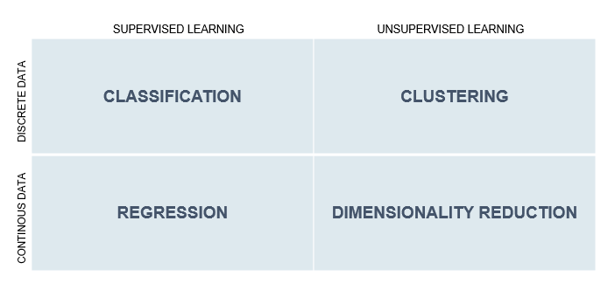

Prediction of binary/categorical variable
In lecture 1 we have defined regression using the following example :
House price prediction example
x_{h} ϵ R^{n} = $\left[\begin{matrix}x_{1} \\ x_{2} \\ \begin{matrix}⋮ \\ x_{n}\end{matrix}\end{matrix}\right]$ = $\left[\begin{matrix}surface \\ num. bedrooms \\ \begin{matrix}⋮ \\ location\end{matrix}\end{matrix}\right]$ y_{h} ϵ R : price
Regression: infer the function , given a training set of labelled examples (continuous data).
f_{h}
f_{h}
Principles of supervised ML
Computation for Transportation Engineering – Hilary Term 2024

Slide 16

Prediction of binary/categorical variable
We want to consider now a supervised learning problem where the labels are discrete
Classification
x ϵ R^{n} = $\left[\begin{matrix}x_{1} \\ x_{2} \\ \begin{matrix}⋮ \\ x_{n}\end{matrix}\end{matrix}\right]$ y
Classification: infer the function , given a training set of labelled examples (discrete data).
{0,1}, {True, False}, {Healthy, Degraded}, …
f_{c}
{1,2,….N}
{cat, dog, monkey…}
{inner race fault, ball defect, outer race fault…} ,…
f_{c}
Issues:
Performance assessment
Some classes are rare
(Non)-linearity of the model
Principles of supervised ML
Computation for Transportation Engineering – Hilary Term 2024

Slide 17
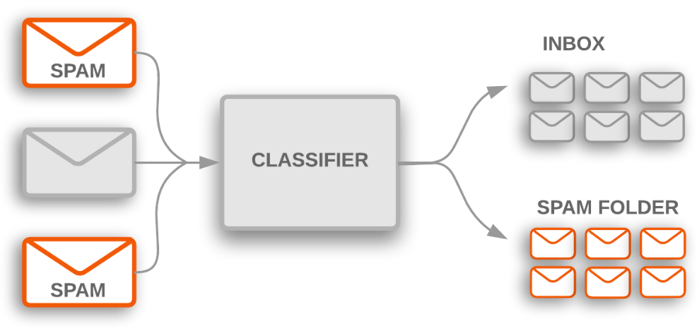
Prediction of binary/categorical variable
source: Google Machine Learning guide – Introduction to Text Classification
Principles of supervised ML
Computation for Transportation Engineering – Hilary Term 2024

Slide 18



Prediction of binary/categorical variable
Trains available for operation
Trains to send for maintenance
Principles of supervised ML
Computation for Transportation Engineering – Hilary Term 2024

Slide 19

Prediction of binary/categorical variable
Decision threshold
Principles of supervised ML
Computation for Transportation Engineering – Hilary Term 2024

Slide 20
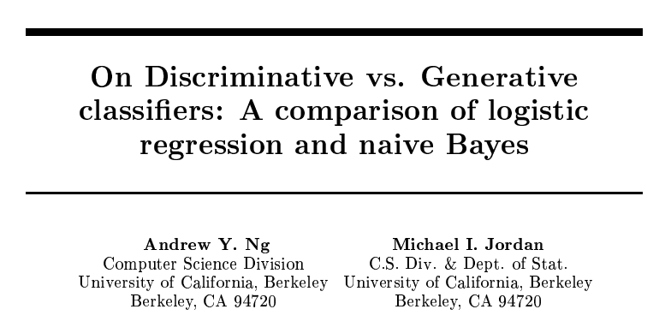
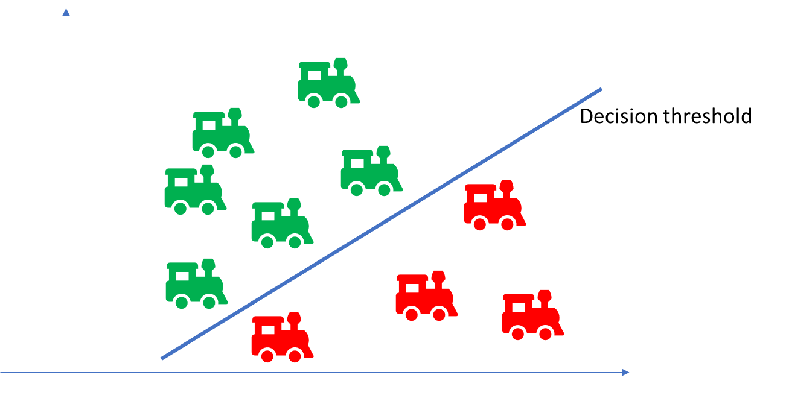
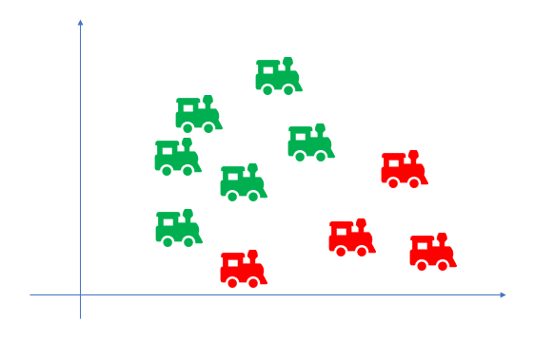
Discriminative vs Generative classifiers
Discriminative Classifiers
Generative Classifiers
Learn directly the map between the input and the class labels (i.e. p(y|x)).
Focus on the decision boundary
Smaller error
Black-box
E.g. Logistic regression
Support Vector Machines
Decision trees
Learn a model of the joint probability p(x,y), of the input x and of the labels y, and then get p(y|x) using Bayes’ rule.
Quick to implement and run (faster convergence)
Incorporation of expert knowledge
Scale to massive dataset
E.g. Naïve Bayes
Gaussian Discriminant Analysis (GDA)
Bayesian Network model
discriminative
generative
Principles of supervised ML
Computation for Transportation Engineering – Hilary Term 2024

Slide 21
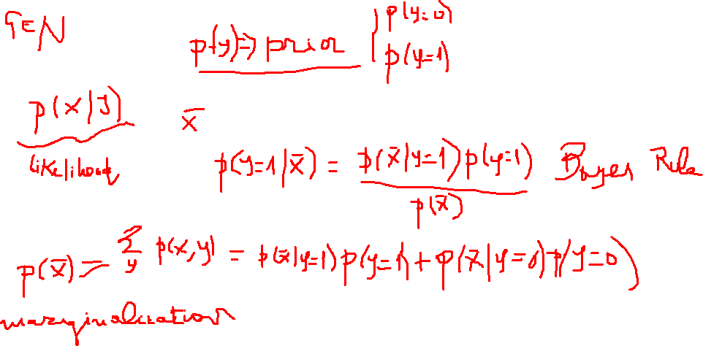
Discriminative vs Generative classifiers
Principles of supervised ML
Computation for Transportation Engineering – Hilary Term 2024

Slide 22

Logistic regression
The linear regression formulation can be adapted to solve classification problems.
Regression can be cast in terms of maximizing a likelihood.
Convert the expression${ y}_{θ}^{(i)}= θ^{T}x^{(i)}∈ℝ$ into a probability ${ p}_{θ}\left(y^{(i)}| x^{\left(i\right)};θ\right)∈\left[0,1\right]$
How to restrain the linear regression to the interval [0,1]?
Principles of supervised ML
Computation for Transportation Engineering – Hilary Term 2024

Slide 23
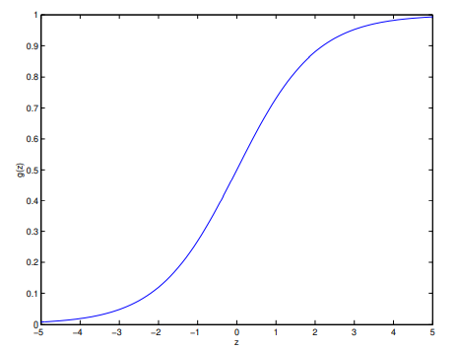



Logistic regression
The linear regression formulation can be adapted to solve classification problems.
Regression can be cast in terms of maximizing a likelihood
Convert the expression${ y}_{θ}^{(i)}= θ^{T}x^{(i)}∈ℝ$ into a probability ${ p}_{θ}\left(y^{(i)}| x^{\left(i\right)};θ\right)∈\left[0,1\right]$
Use the logistic (or sigmoid) function $σ\left(z\right)= \frac{1}{1+e^{−z}}→σ\left(θ^{T}x^{(i)}\right)=\frac{1}{1+e^{−θ^{T}x^{(i)}}}$
Inference: with probability threshold=0.5 (in this configuration)
${ y}_{θ}^{(i)}=$ $σ\left(θ^{T}x^{(i)}\right)$
$${ y}_{θ}^{(i)}\underset{→}{ bin} \left\{\begin{aligned}1,θ^{T}x^{(i)}>0 \\ 0 otherwise\end{aligned}\right.$$
Logistic regression model prediction
Principles of supervised ML
Computation for Transportation Engineering – Hilary Term 2024

Slide 24
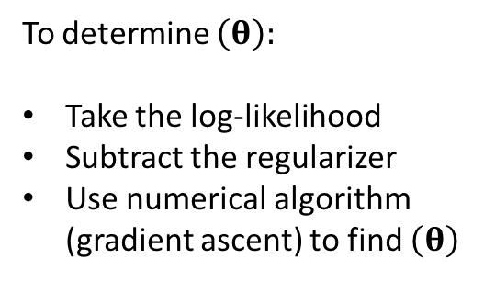
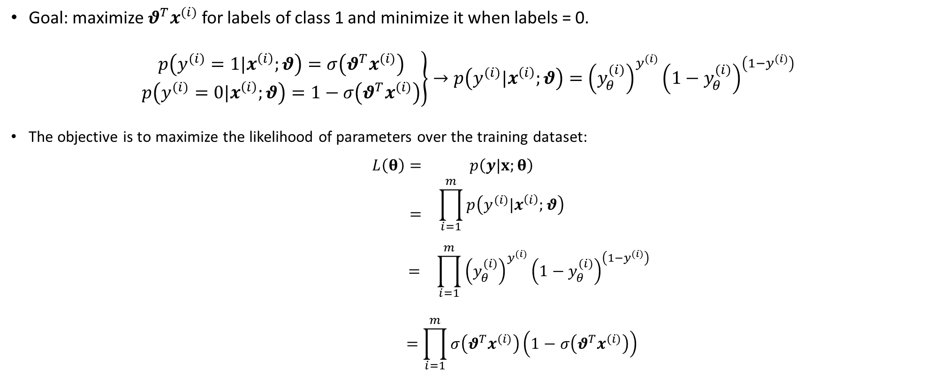
Logistic regression training
Goal: maximize $θ^{T}x^{(i)}$ for labels of class 1 and minimize it when labels = 0.
$$\left.\begin{matrix}p\left(y^{(i)}=1|x^{\left(i\right)};θ\right)=σ\left(θ^{T}x^{(i)}\right) \\ p\left(y^{(i)}=0|x^{\left(i\right)};θ\right)=1−σ\left(θ^{T}x^{(i)}\right)\end{matrix}\right\}→p\left(y^{(i)}|x^{\left(i\right)};θ\right)={\left(y_{θ}^{(i)}\right)}^{y^{(i)}}{\left(1−y_{θ}^{(i)}\right)}^{\left(1−y^{(i)}\right)}$$
The objective is to maximize the likelihood of parameters over the training dataset:
$$\begin{matrix}L\left(θ\right)= & p\left(y|x;θ\right) \\ = & \begin{aligned}\prod_{i=1}^{m}{p\left(y^{(i)}|x^{\left(i\right)};θ\right)} \\ \end{aligned}\end{matrix}$$
$$\begin{matrix} = & \prod_{i=1}^{m}{{\left(y_{θ}^{(i)}\right)}^{y^{(i)}}{\left(1−y_{θ}^{(i)}\right)}^{\left(1−y^{(i)}\right)}}\end{matrix}$$
$$=\prod_{i=1}^{m}{σ\left(θ^{T}x^{(i)}\right)\left(1−σ\left(θ^{T}x^{(i)}\right)\right)}$$
To determine $\left(θ\right):$
Take the log-likelihood
Subtract the regularizer
Use numerical algorithm (gradient ascent) to find $\left(θ\right)$
Why subtract?
Principles of supervised ML
Computation for Transportation Engineering – Hilary Term 2024

Slide 25

Support Vector Machines
Find a separating hyperplane for doing classification.
x₂
$$θ^{T}x−α=0$$
x₁
Principles of supervised ML
Computation for Transportation Engineering – Hilary Term 2024

Slide 26



Support Vector Machines
Find a separating hyperplane for doing classification.
$$θ_{2}^{T}x−α_{2}=0$$
x₂
$$θ_{1}^{T}x−α_{1}=0$$
How to determine the best hyperplane?
$$θ_{3}^{T}x−α_{3}=0$$
x₁
Principles of supervised ML
Computation for Transportation Engineering – Hilary Term 2024

Slide 27
Support Vector Machines
Find a separating hyperplane for doing classification.
$$θ_{2}^{T}x−α_{2}=0$$
x₂
$$θ_{1}^{T}x−α_{1}=0$$
How to determine the best hyperplane?
$$θ_{3}^{T}x−α_{3}=0$$
Penalize misclassifications!
Find the one that makes the biggest margin, between the two classes.
x₁
Principles of supervised ML
Computation for Transportation Engineering – Hilary Term 2024

Slide 28






Support Vector Machines training
Seek the classifier (line) that maximizes the distance separating the pair of nearest points from the two classes.
$$θ^{T}x−α=1$$
$$θ^{T}x−α=0$$
x₂
$$θ^{T}x−α=−1$$
$$\frac{1}{\left\|θ\right\|}$$
x₁
Support vectors
Principles of supervised ML
Computation for Transportation Engineering – Hilary Term 2024

Slide 29


Support Vector Machines – hard margin
Seek the classifier (line) that maximizes the distance separating the pair of nearest points from the two classes.
$$θ^{T}x−α=1$$
$$θ^{T}x−α=0$$
x₂
Linearly separable data (“hard margin”).
$$θ^{T}x−α=−1$$
Solve the optimization problem:
$$\min_{θ,α}{\frac{1}{2}}{\left\|θ\right\|}_{2}^{2}$$
$$s.t. { y}^{(i)}\left(θ^{T}x^{(i)}−α\right)≥1 ∀ i=1,…m$$
$$\frac{1}{\left\|θ\right\|}$$
$${ y}^{(i)}∈\{1,−1\}$$
x₁
Support vectors
Principles of supervised ML
Computation for Transportation Engineering – Hilary Term 2024

Slide 30


Support Vector Machines – soft margin
In practice, data points are rarely linearly separable.
Extend the formulation for the case where data are not perfectly linearly separable
Consider a function that is zero if the example i lies on the correct side of the margin,
and whose value is proportional to the distance from the margin for if i is misclassified (i.e. if not all points are correctly classified, a penalty is added).
$$\min_{θ,α,ξ }{\frac{1}{2}}{\left\|θ\right\|}_{2}^{2}+C\sum_{i}{ξ_{i}}$$
$$s.t. { y}^{(i)}\left(θ^{T}x^{(i)}−α\right)≥1−ξ_{i},ξ_{i}≥0 ∀ i=1,…m$$
Principles of supervised ML
Computation for Transportation Engineering – Hilary Term 2024

